Slide 1
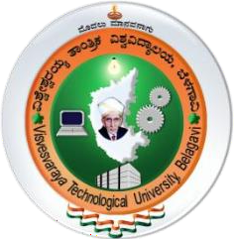

VISVESVARAYA TECHNOLOGICAL UNIVERSITY BELAGAVI – 590018 NAVKIS COLLEGE OF ENGINEERING , HASSAN-2023-24 Major Project presentation on(18ECP83):
“Solstride Energy Management System”
Under the guidance of : Presented by :
Mrs. Siddika Sabahath Anjum BE,M.Tech.,(Ph.d) Darshan M R 4YG20EC004
Assistant professor Gagana S N 4YG20EC005
Department of ECE Nischitha Siddappa G P 4YG20EC017
NCE, Hassan Thejas Gowda M R 4YG20EC021
Department of Electronic and Communication Engineering
Navkis college of Engineering, Hassan – 573217
2023 - 2024

Slide 2
CONTENTS :
INTRODUCTION
LITERATURE SURVEY
PROBLEM STATEMENT
OBJECTIVES
METHODOLOGY
COMPONENTS
EXPECTED RESULTS
CONCLUSION
REFERENCES

Slide 3
1.INTRODUCTION :
Electricity is the most practical and adaptable energy source, has a large demand, is growing more quickly than other energy sources, and is essential to both industrial and agricultural processes.
Walking is a typical daily activity that many individuals engage in. As a result, the human energy contained in each footstep can be transformed into electrical energy.
The system is integration of two distinct complementary renewable energy sources .This innovative combination sets the project apart by maximizing energy capture potential , providing a continuous and diversified energy supply.
The synchronization of these technologies allows the system to adopt to varying environmental conditions and making it a versatile and dynamic solution for sustainable power generation.

Slide 4
LITERATURE SURVEY :
Author Name | Name of Paper | Year | Aim
Mr. Chetan S Alkori Mr. Tushar | “Power Generation using Foot-step and P.V panel” | 2022 | Main aim of this paper is to convert non conventional energy from walking foot step and P.V panel into electrical energy.
Thirumalaikumaran R. Anmesh S. Murugesan | “Design and fabrication of prototype foot step electricity generator” | 2023 | In this paper, a simple & get low cost mechanism has been proposed to enhance the performance & efficiency of Energy conversion from electricity Energy.
K. Sai Manikanta Md. Abdul Haadi S. Pawan Kumar M. Naresh | “Foot step power generation by using Rack and Pinion Mechanism” | 2023 | In this paper the system generates power using footstep force and this system serves as a medium to generate electricity using non conventional energy.
Lorinda E. Pascual Christopher M. Ladignon Jerome M. Yabot | “Electricity Generation using Spring – Powered floor pad” | 2020 | In this paper the design and construction of power generating floor pad which can be used to harvest electricity from foot steps.

Slide 5
1.1 PROJECT OBJECTIVES :
To generate the electricity through the human foot step.
To provide electricity in rural area.
To save conventional energy sources.
To store the electricity for further use.
To produce electricity while rack moves in both upward and downward directions.

Slide 6
1.2 PROBLEM STATEMENT:
Most of the nation's electricity was generated by natural gas, Non-renewable sources, coal, and nuclear energy which effect the environment.
Rising prices of oil and gases and their potential shortages have raised uncertainties about the security of energy supply in future, which has serious repercussions on the growth of the national economy.
The main factor is increasing use of fossil fuels also causes serious environmental problems. Hence there is primary need to use renewable energy sources like solar ,wind.

Slide 7

2.METHODOLOGY :
Foot Step
Arrangement
Rack and Pinion
DC Generator
Solar Panel
Lead Acid Battery
Controller
Bulb
Arduino UNO
16 x 2 Display

Slide 8
When force is applied on Wood slab by stamping on it the spring gets compressed.
The rack and pinion arrangement made when the pressure is applied the linear motion is converted into rotational motion.
The system produced by using rack and pinion arrangement and solar gives better efficiency.
The Number of rotation of pinion is depend Number of teeth in the rack.
The Rotating part of Pinion is connect to DC Generator, as it turns it drives the Generates converting mechanical Energy into electrical Energy
LED is connected to output of DC Generator so LED will light up when the Generator produces electricity indicating power Generation.
Using a multimeter to measure the voltage and current produced by dc generator.
Solar plate is also included in the system which is placed between wood slab to get maximum output of it.
With the both produced power is stored in the battery which can be used for glowing bulbs , charging phone.
With combining both the mechanism foot step and solar the output can be increased.
Overall , we are converting mechanical energy into electrical energy.

Slide 9
3.COMPONENTS : 3.1Hardware Components :
LCD DISPLAY
RACK AND PINION
SOLAR PANEL
SPRING
ARDUINO UNO
LEAD ACID BATTERY
SOLAR CHARGE CONTROLLER
VOLTAGE SENSOR
IR SENSOR
BULB
DC GENERATOR

Slide 10
3.2 Software Components :
Arduino IDE

Slide 11
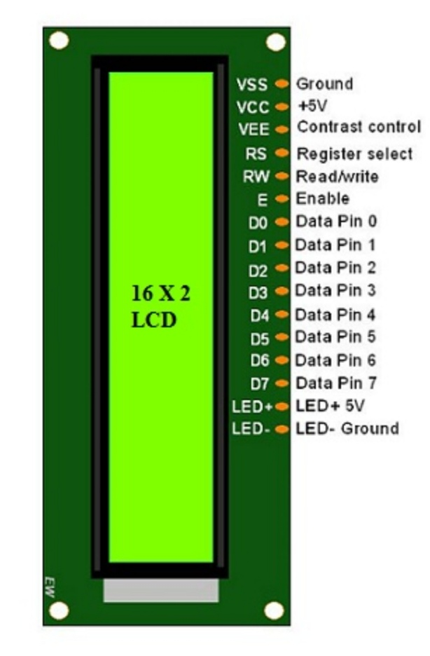
LCD Display :
Displays real-time voltage output from the solar panel and footstep count simultaneously and also display the step count
Utilizes appropriate libraries and functions within the Arduino code to update and display the information accurately.
Fig 3.1.1 LCD Display

Slide 12
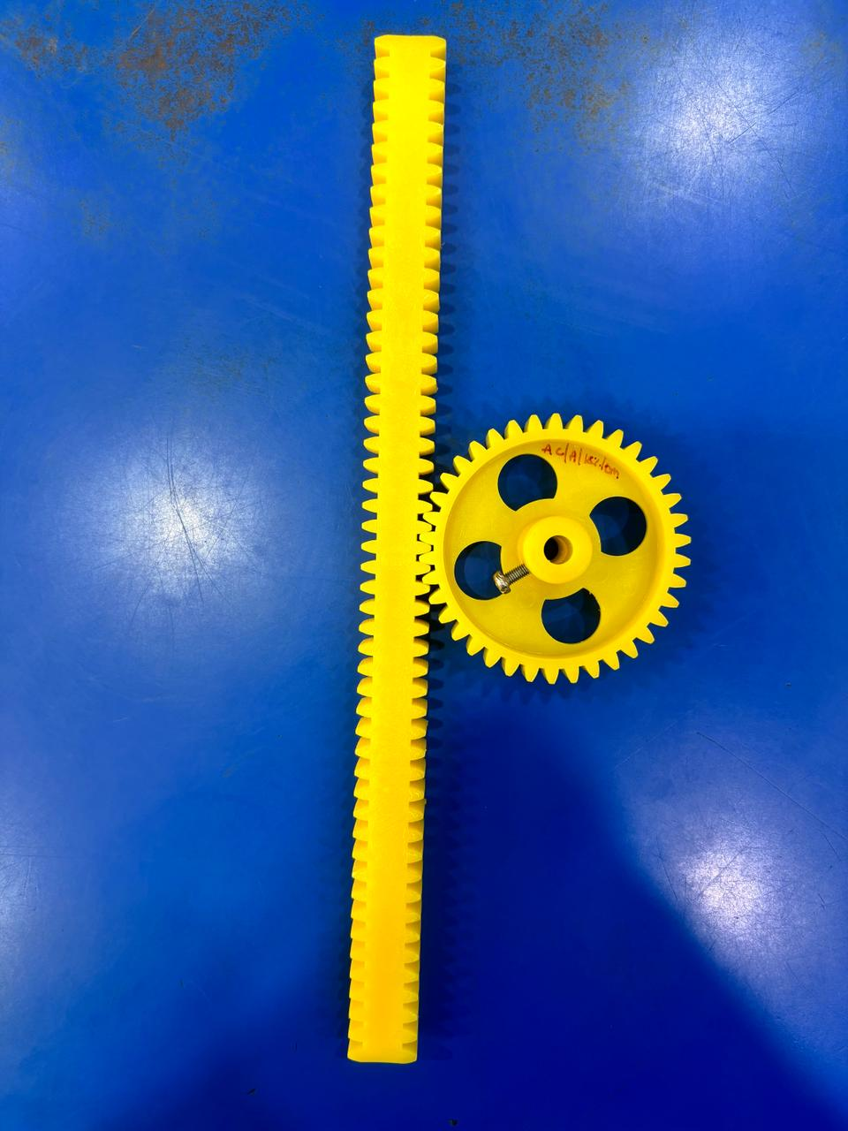
Rack and Pinion :
This mechanism converts the linear motion of footsteps into rotational motion.
As someone steps on it, the rack moves, causing the pinion to rotate.
Fig 3.1.2 Rack and Pinion

Slide 13
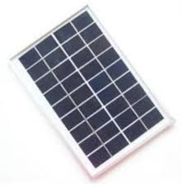
Solar Panel :
Simultaneously, the solar panel converts sunlight into electrical energy.
It generates electricity during daylight hours, providing additional energy to the system.
Fig 3.1.3 Solar Panel

Slide 14
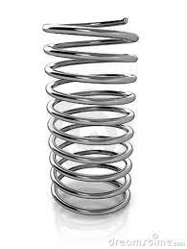
Spring :
The spring acts as a mechanism to store and release energy.
As the rack moves downward with the weight of the footstep, it compresses the spring, storing potential energy.
Fig 3.1.4 Spring

Slide 15
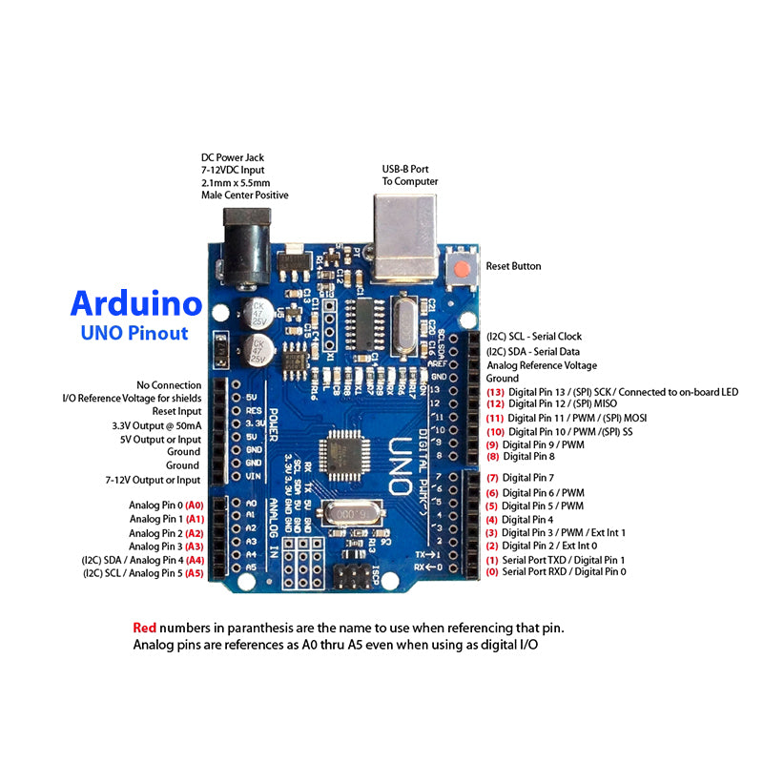
Arduino UNO :
The Arduino Uno is a popular microcontroller board based on the ATmega328P microcontroller.
It is commonly used in prototyping and DIY electronics projects due to its ease of use and wide range of compatible components and shields.
The Arduino Uno supports a voltage range of 5 volts.
Fig 3.1.5 Arduino UNO

Slide 16
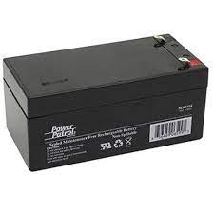
Battery :
Here we are using Lead Acid Battery.
The battery serves as an energy storage device.
It stores the electrical energy generated by both the footstep mechanism and the solar panel for later use, ensuring continuous power supply even when there's no sunlight or foot traffic.
Fig 3.1.6 Battery

Slide 17
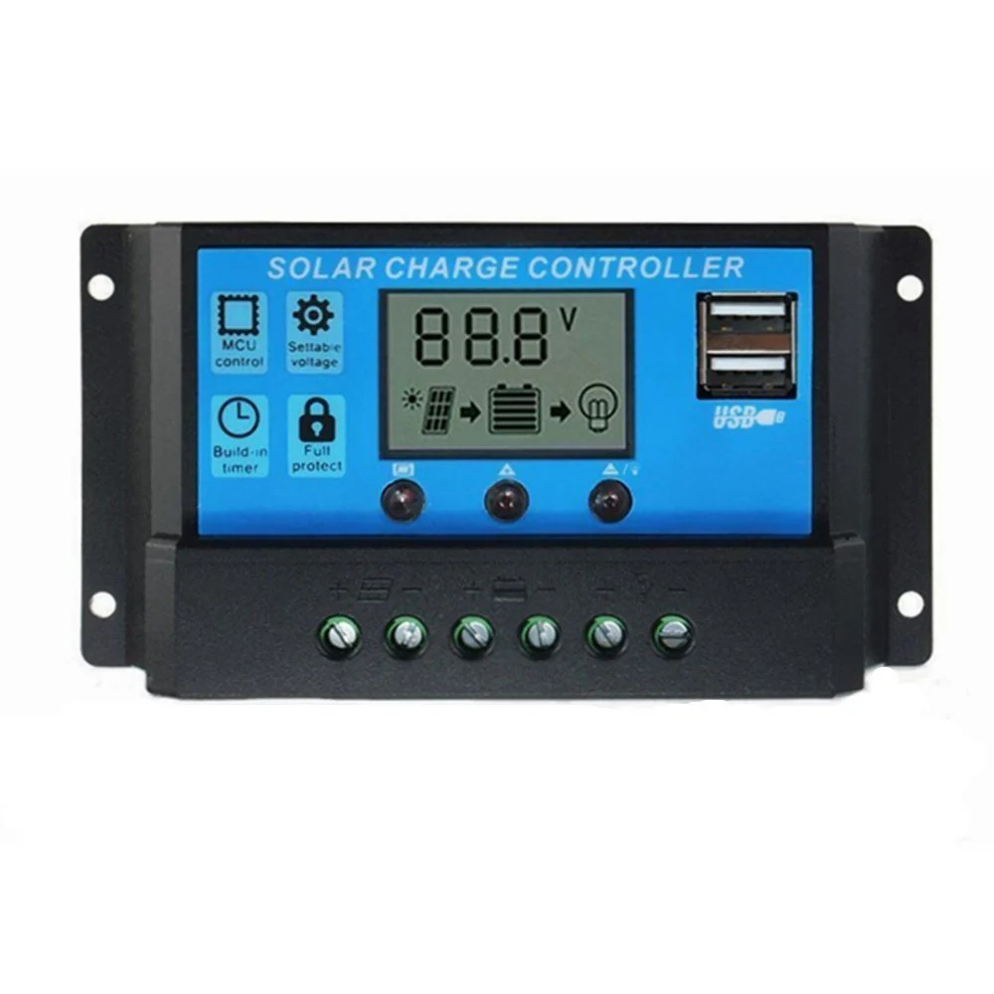
Solar Charge Controller:
It regulates the voltage and current coming from the solar panels going to the battery.
It ensures that the battery is not overcharged or discharged excessively, prolonging its lifespan and maximizing efficiency.
Fig 3.1.7 Solar Charge Controller

Slide 18
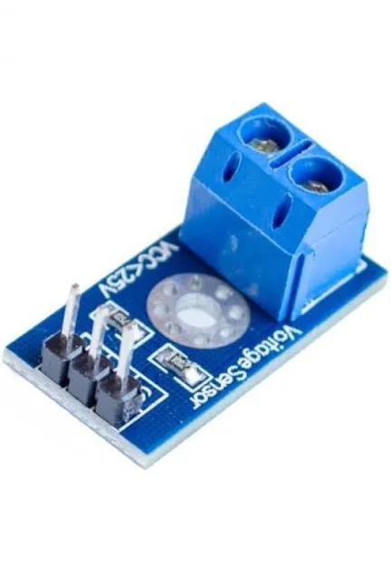
Voltage Sensor :
Voltage sensors are electronic devices used to measure the voltage level in a circuit or system accurately.
Voltage sensors work based on the principle of converting voltage into a measurable output.
Usually in the form of a voltage or current signal that can be read by instrumentation or control systems.
Fig 3.1.8 Voltage Sensor

Slide 19
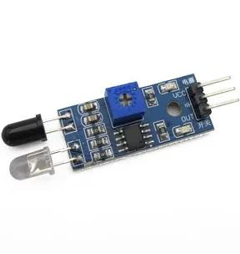
IR Sensor :
An IR (Infrared) sensor is a device that detects infrared radiation emitted by objects in its field of view.
These sensors are commonly used for proximity sensing, object detection, and motion detection.
IR sensors are widely used in applications such as security systems, automatic lighting controls, and proximity sensors in electronic devices like smartphones and tablets.
Fig 3.1.9 IR Sensor

Slide 20
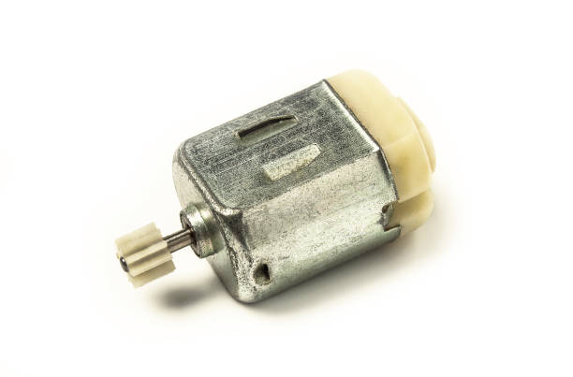
DC Generator :
DC Generator converts mechanical energy into electrical energy.
DC generator that converts the kinetic energy from footfalls into electrical energy through electromagnetic induction.
This setup typically involves a mechanical system like gears and springs to amplify the motion from footsteps.
Fig 3.2 DC Generator

Slide 21
4. Results and Conclusion :
The Expected outcome of footstep power generation using a rack and pinion mechanism combined with solar panels is an environmentally friendly and sustainable energy source.
As individuals walk on the system, their footsteps drive the rack and pinion, converting mechanical energy into electrical energy.
This integrated approach aims to provide a continuous and renewable power source, particularly in high-traffic areas or public spaces, contributing to cleaner energy solutions.

Slide 22
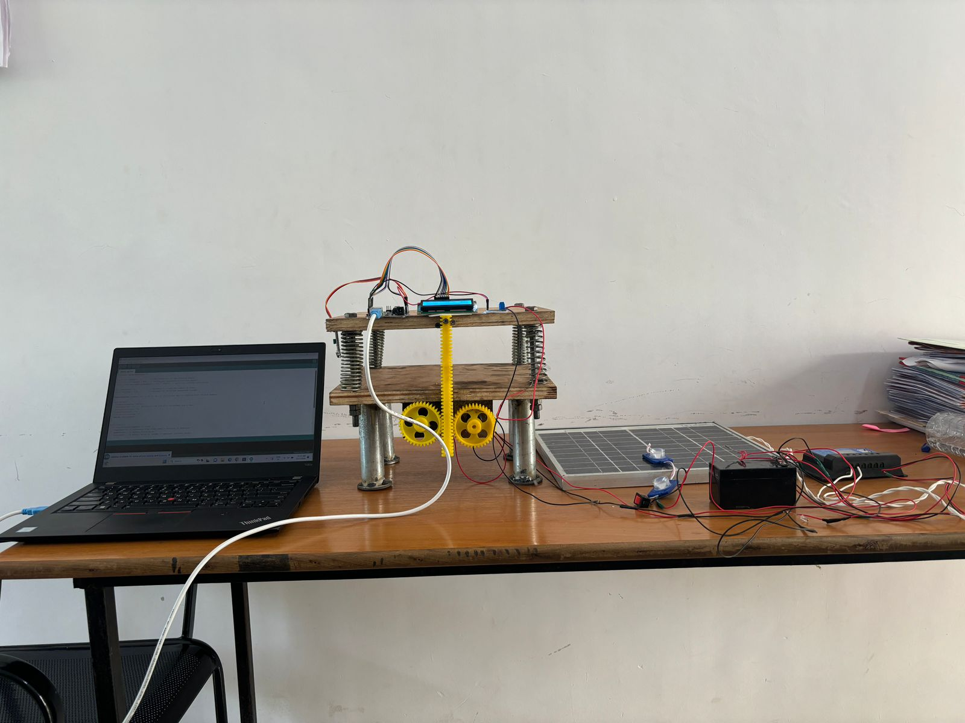
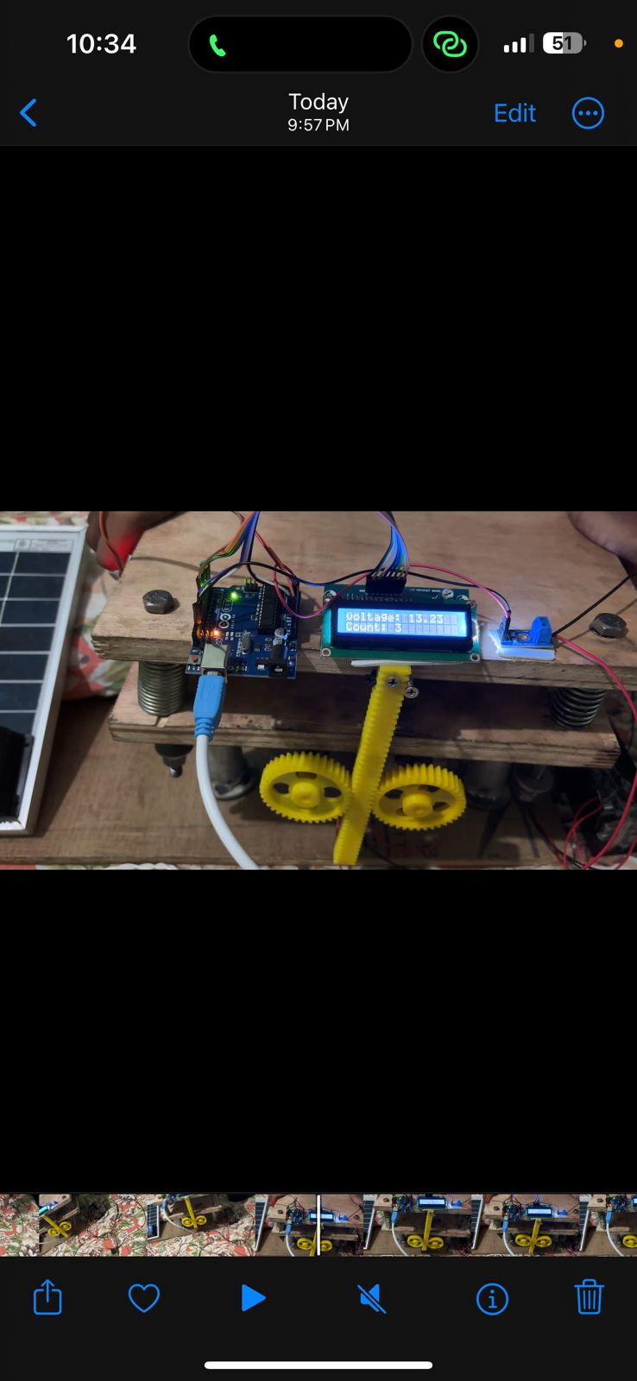
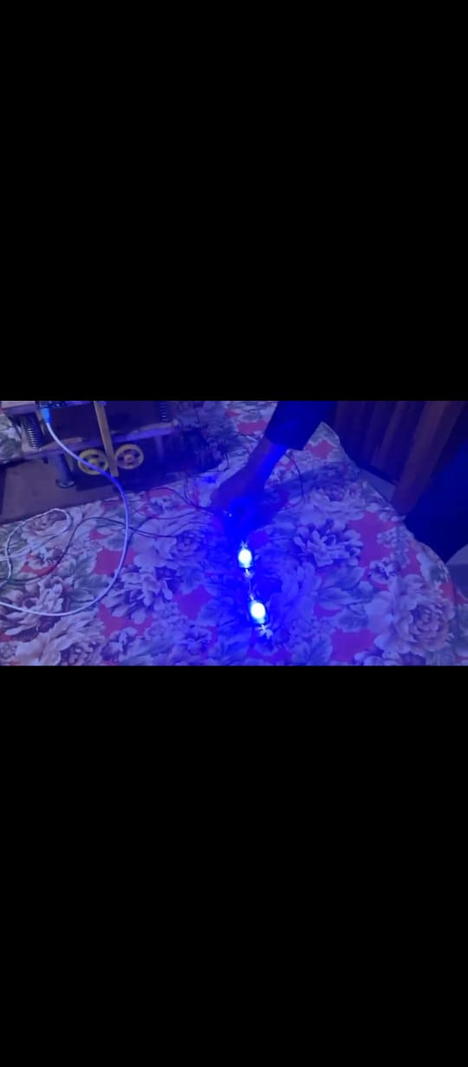
OUTPUTS :

Slide 23
REFERENCES :
Mr. Chetan S. Alkori, Mr. Tushar Sona wane, Mr. Yashwant Badgajar , Mr. Bhushan S. Gale “Power Generation using Foot-Step and P.V. Panel,” Department of Mechanical Engineering ,volume 2, issue 9,June2022.
A. Thirumalaikumaran, R. Anmesh, S. Murugesan and S. Saran, “ DESIGN AND FABRICATION OF PROTOTYPE FOOT STEP ELECTRICITY GENERATOR “,volume 12, issue 6, June 2023.
K. Sai Manikanta, Md. Abdul Haadi, M. Jayendra Prasad, S. Pawan Kumar,”Footstep Power Generation by Using Rack and Pinion Mechanism”, International Journal of Research, Volume 06, issue 6,June 2023.
Lorinda E. Pascual, Christopher M. Ladignon, Jerome M. Yabot, Francis Victor, “Electricity Generation Using Spring-Powered Floor Pad”, Volume 05, Issue 12, December 2020.

Slide 24
THANK YOU
.

